Slide 1

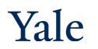
VAEs and data generation
CPSC/AMTH 452/552
CBB 663

Slide 2
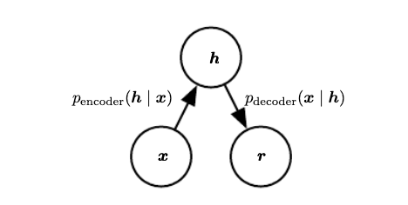
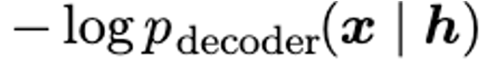
Recall
Autoencoders can be thought of as latent variable models if the encoder is stochastic
Then the autoencoder training actually corresponds to minimizing negative log likelihood

Slide 3
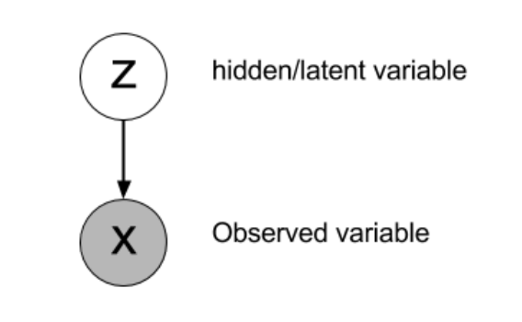
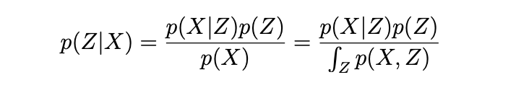
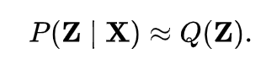
VAEs and Variational Inference
Intractible to
Compute! But can use sampling!
Posterior approximated with a variational distribution Q(Z)
which has a fairly simple form, i.e. from a family of Gaussians.

Slide 4
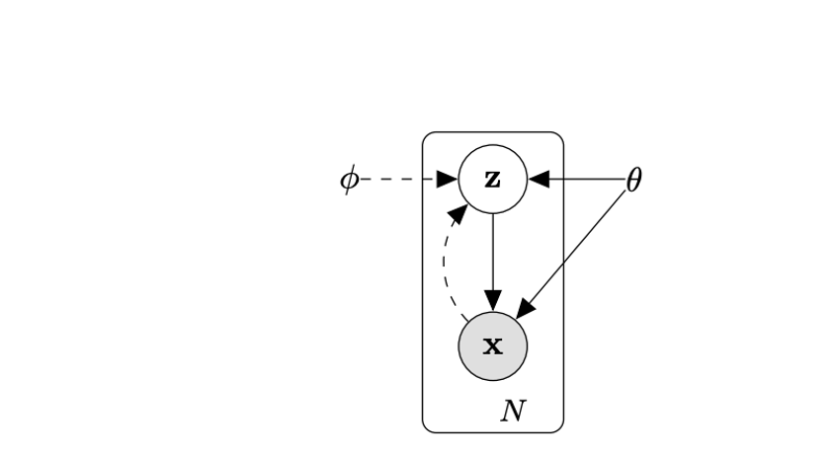
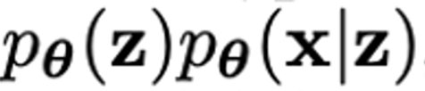
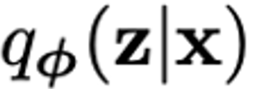
VAEs and Variational Inference
Solid lines are the generative model
Dashed lines are the variational approximation

Slide 5
Basic Idea of VAEs
Use a parametric form of Q(Z)
There are two kinds of parameters
Variational parameters
Neural network parameters
Use gradient descent to optimize it
But neural networks don’t do well with equality constraints so use an inequality to approximate it called ELBO (evidence based lower bound)
Use sampling of datapoints and variational parameters to come up with all other terms!

Slide 6
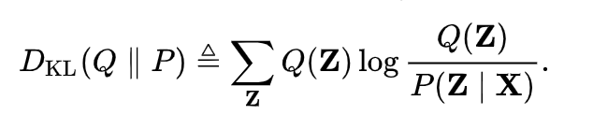
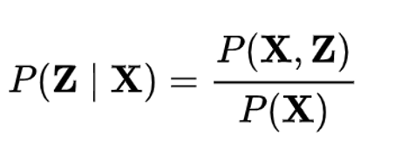
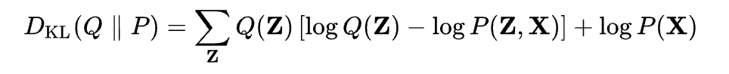
Variational Bayes (Detour)
Most common form minimizes KL-divergence
Given that
KL divergence can be written as:
Since P(X) is a constant and Q(z) sums to 1 over all z’s

Slide 7
Variational Bayes Continued
This can be rewritten in terms of expectation over Q(Z):
Rearranging terms to get log P(X) on one side gives:
Here the last term is called the variational free energy
Maximizing variational free energy minimizes divergence this term because log of evidence is fixed
In this sense the variational free energy forms a bound log P(X)>L(Q)

Slide 8
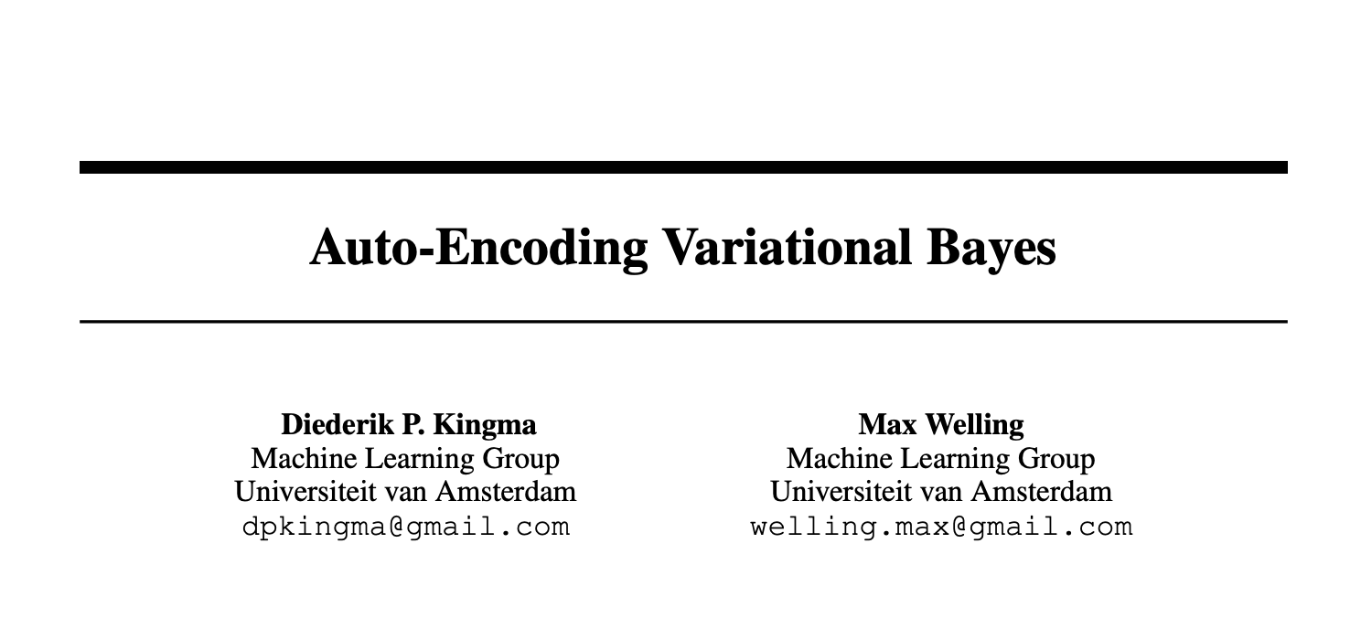
VAEs

Slide 9
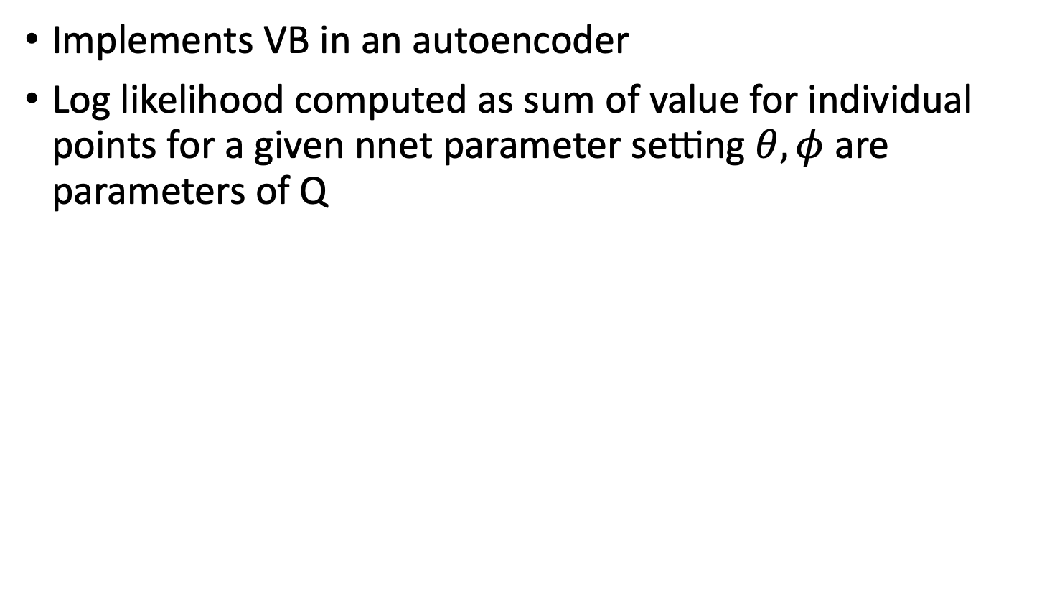
Autoencoding Variational Bayes
Implements VB in an autoencoder
Log likelihood computed as sum of value for individual points for a given nnet parameter setting $θ,φ$ are parameters of Q

Slide 10
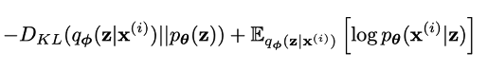
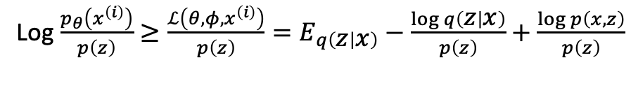
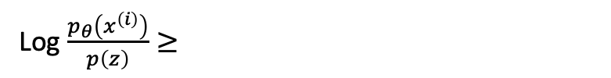
Autoencoding Variational Bayes
Can condition the whole analysis over the z, given a prior on z, p(z)
In a neural network prior p(z) corresponds to the way the latent variables are desired to be shaped
This gives:
Log $\frac{p_{θ}\left(x^{\left(i\right)}\right)}{p\left(z\right)}≥\frac{ℒ\left(θ,φ, x^{\left(i\right)}\right)}{p\left(z\right)}=E_{q\left(z | x\right)}−\frac{\log{q\left(z | x\right)}}{p\left(z\right)}+\frac{\log{p\left(x,z\right)}}{p\left(z\right)}$
Log $\frac{p_{θ}\left(x^{\left(i\right)}\right)}{p\left(z\right)}≥$

Slide 11
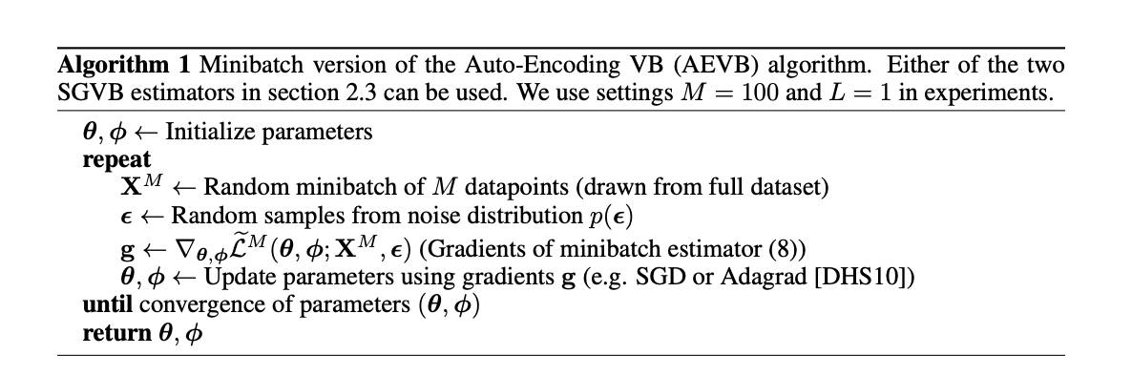
Autoencoding Variational Bayes
VAEs use gradient descent to maximize variational free energy
Use a parametric (neural network parameterized form) Q(Z) and sampling-based estimate of P(Z,X)

Slide 12
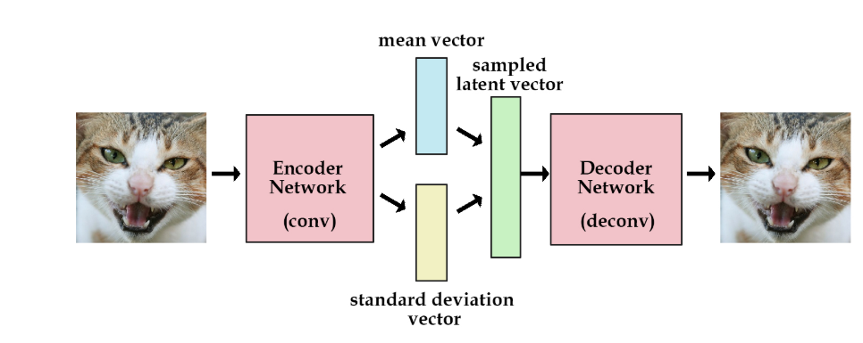
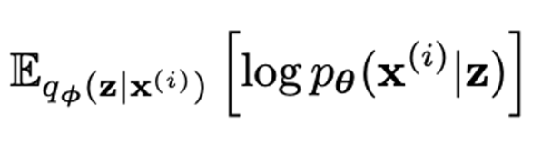
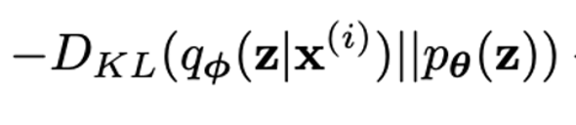
Autoencoding Variational Bayes
Think of the
encoder computing q(z|x)
decoder as computing p(x|z) to reobtain x
p(z) is a prior distribution on z
Maximizing the variational lower bound L(q) of a probability distribution
Two terms in the loss function
KL Divergence Term
Log Likelihood Term

Slide 13
Data Generation with Autoencoders

Slide 14
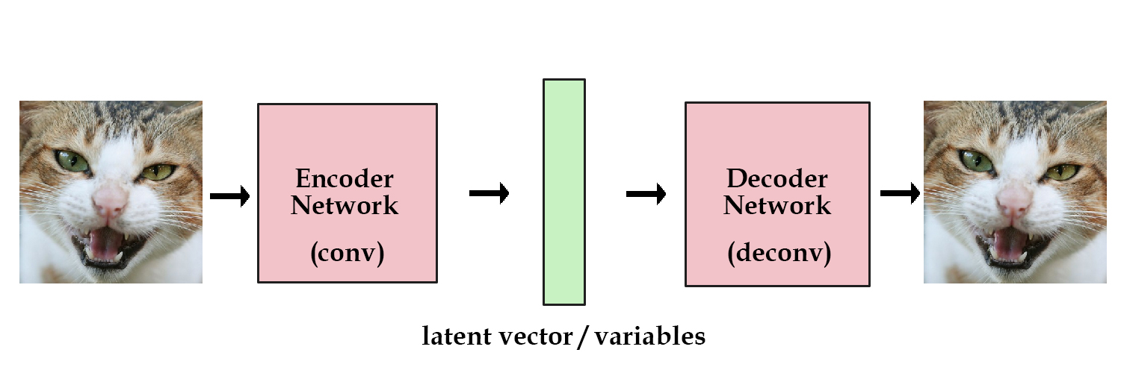
Variational Autoencoders (VAEs)
Learning latent variables that allow for sampling
We want to generate new examples just by sampling in the latent space
Notes:
Shifting gears now to generative models
Ask them for any ideas?

Slide 15
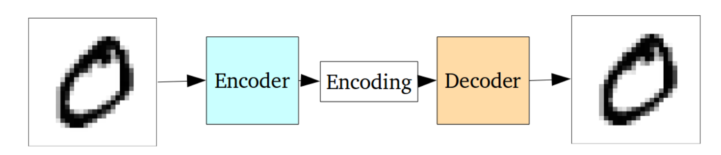
Why not regular autoencoders?
Optimized with Reconstruction Loss
Not explicitly penalized for Generative Purposes

Slide 16
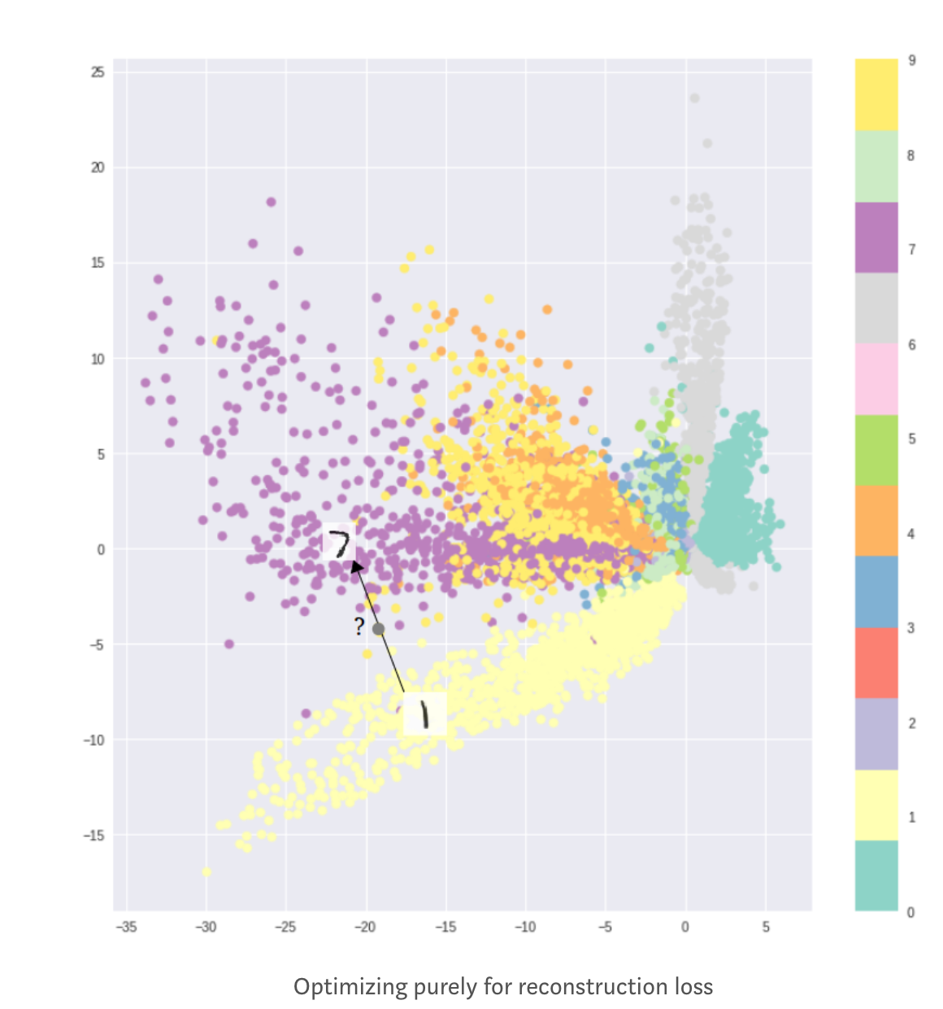
Latent Space Not Optimal for Generation
Formation of clusters helps decoding
Does not help generation
Latent space cannot be interpolated

Slide 17
Variational Autoencoders (VAEs)
Force the latent vectors to have (roughly) a unit Gaussian distribution
Generate images by sampling a unit Gaussian and passing it into the decoder

Slide 18
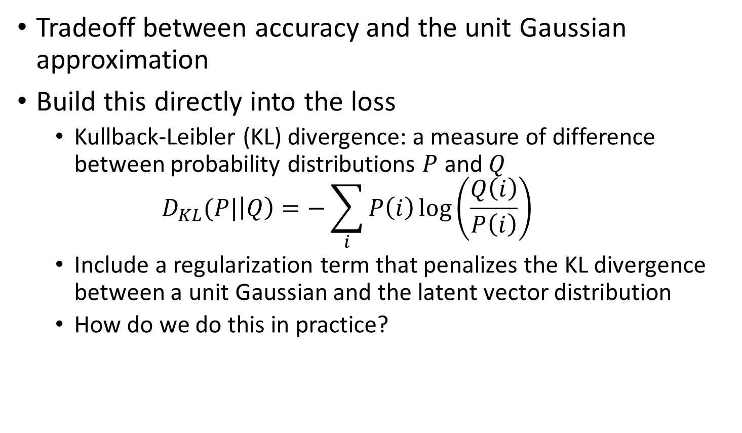
Variational Autoencoders (VAEs)
Tradeoff between accuracy and the unit Gaussian approximation
Build this directly into the loss
Kullback-Leibler (KL) divergence: a measure of difference between probability distributions $P$ and $Q$ $D_{KL}(P|\left|Q\right)=−\sum_{i}{P\left(i\right)\log\left(\frac{Q\left(i\right)}{P\left(i\right)}\right)}$
Include a regularization term that penalizes the KL divergence between a unit Gaussian and the latent vector distribution
How do we do this in practice?
Notes:
For the continuous version, you can take an integral instead

Slide 19
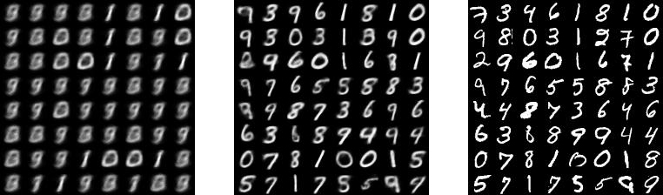
Variational Autoencoders (VAEs)
1st Epoch
9th Epoch
Original

Slide 20
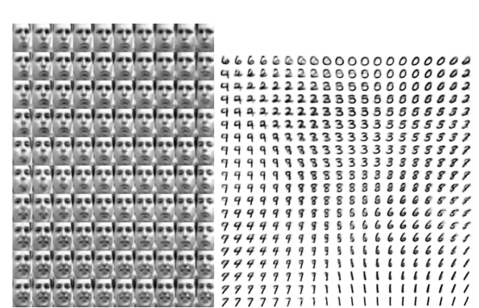
Variational Autoencoders (VAEs)
2D latent mapping of results from VAEs
Notes:
In this case, the latent variable had two nodes and so these are samples that spanned that 2d space. These are all generated images. For the faces, horizontal corresponds to rotation of the face while vertical corresponds to emotional expression.

Slide 21
VAEs Revisited- Want Dense Middle Layer

Slide 22
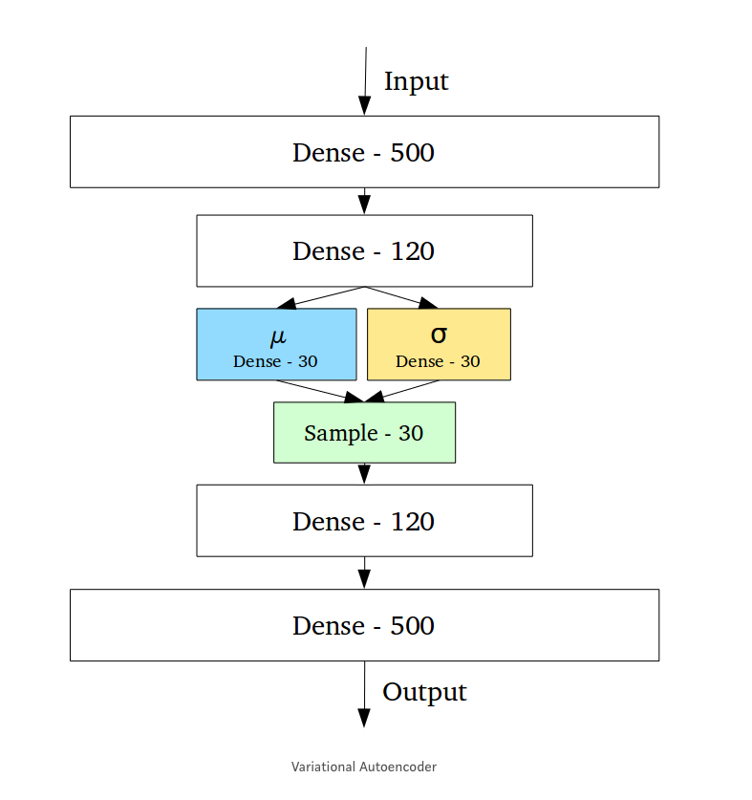
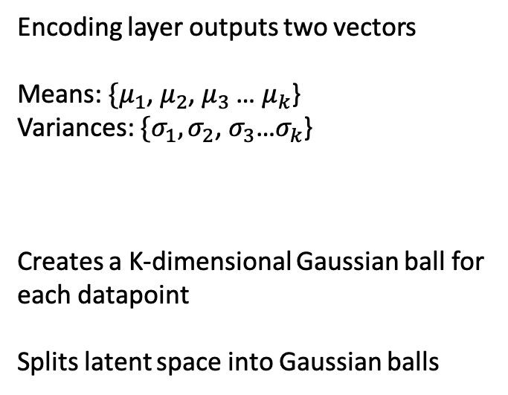
Designed for Sampling
Encoding layer outputs two vectors
Means: $\{μ_{1}$, $μ_{2}$, $μ_{3}$ … $μ_{k}$}
Variances: $\{σ_{1}{, σ}_{2}$, $σ_{3}$…$σ_{k}$}
Creates a K-dimensional Gaussian ball for
each datapoint
Splits latent space into Gaussian balls

Slide 23
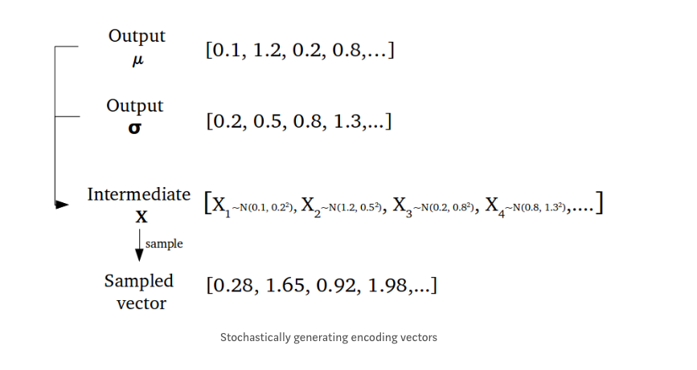
Sampling a vector in latent space

Slide 24
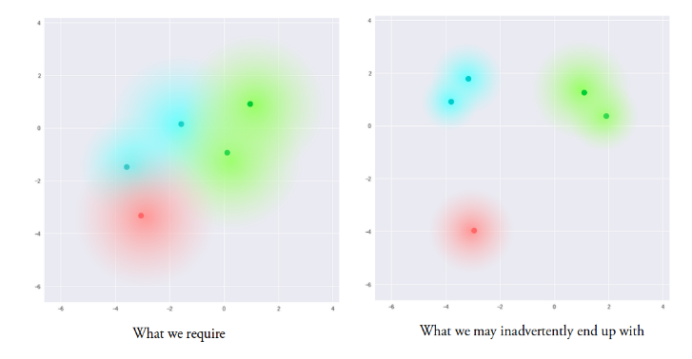
Discouraging Clusters
Solution: Penalize the Gaussian balls if they don’t overlap!

Slide 25
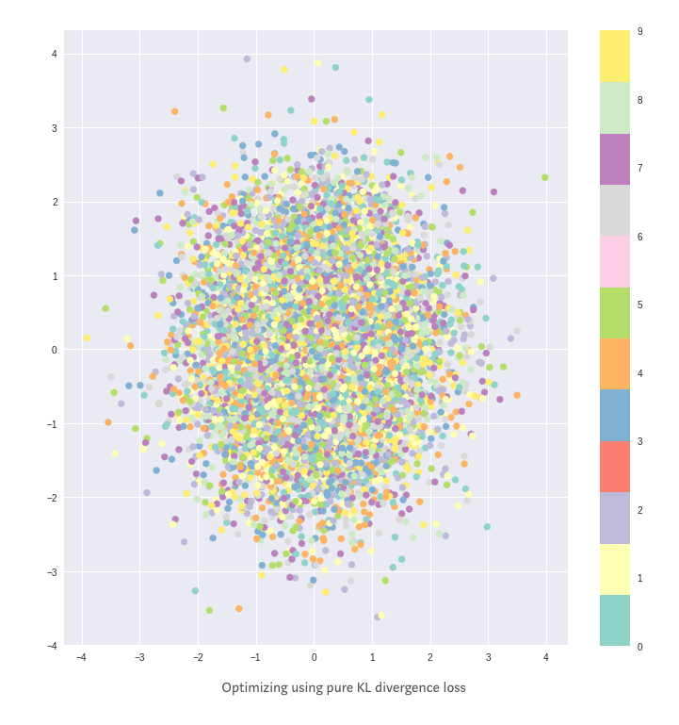
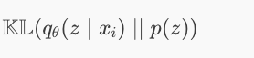
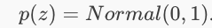
KL Divergence Penalty
Penalizing distributions
In the latent space from being
too far from a standard normal
Encourages every ball to be the same!

Slide 26
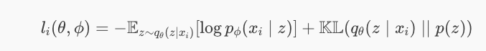
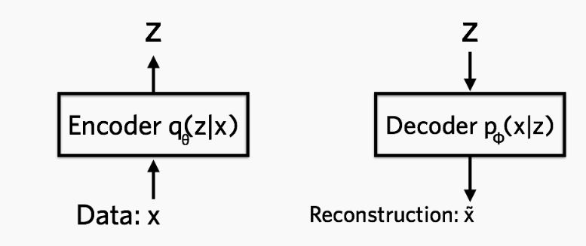
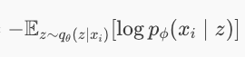
Loss Function of VAE
Reconstruction penalty encourages separation

Slide 27
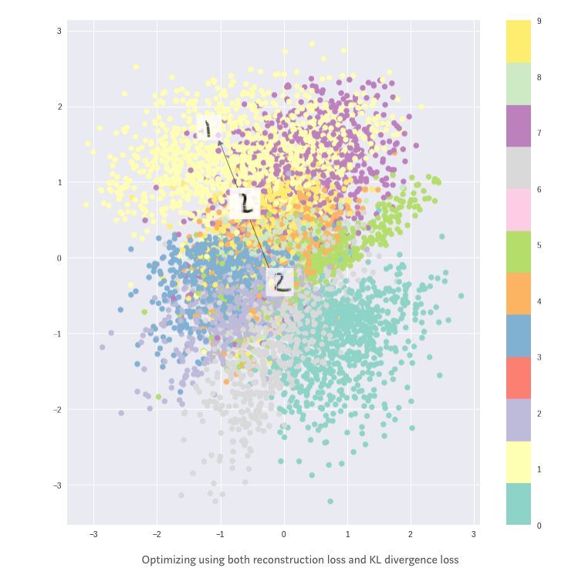
KL+Reconstruction Loss

Slide 28
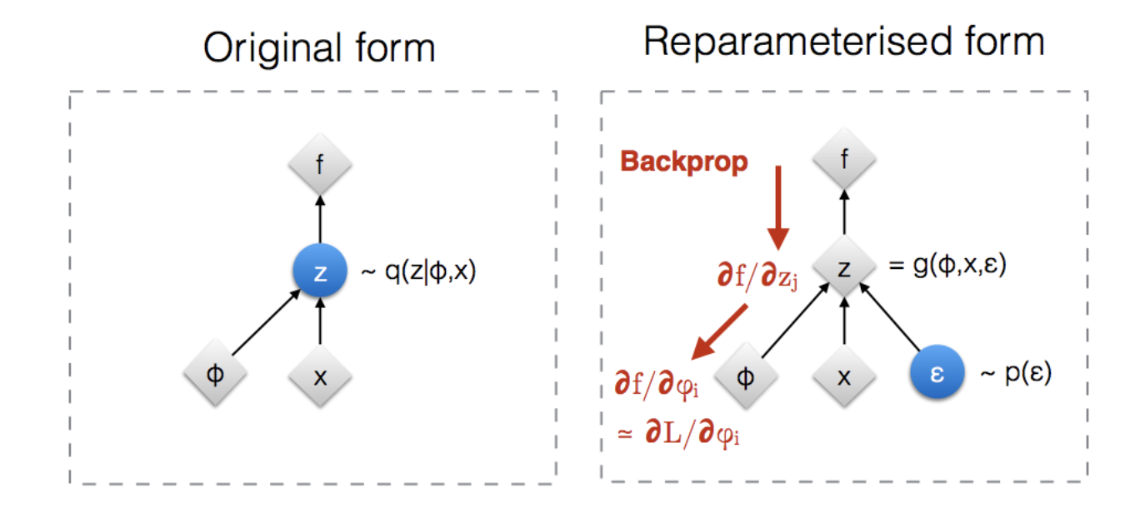
Training a VAE with sampling

Slide 29
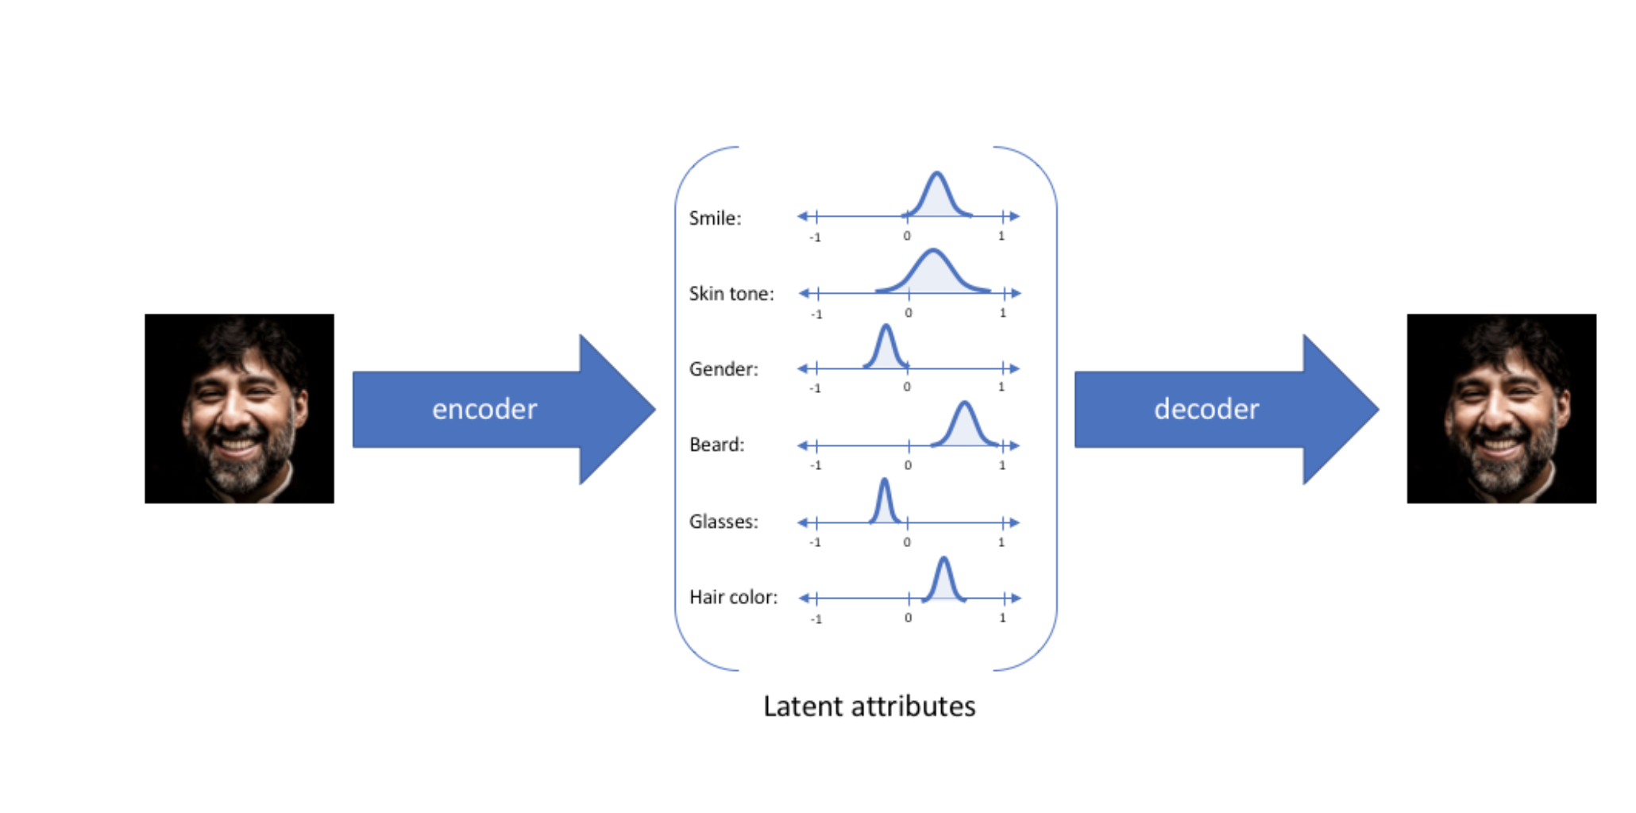
Example
From: https://www.jeremyjordan.me/variational-autoencoders/

Slide 30
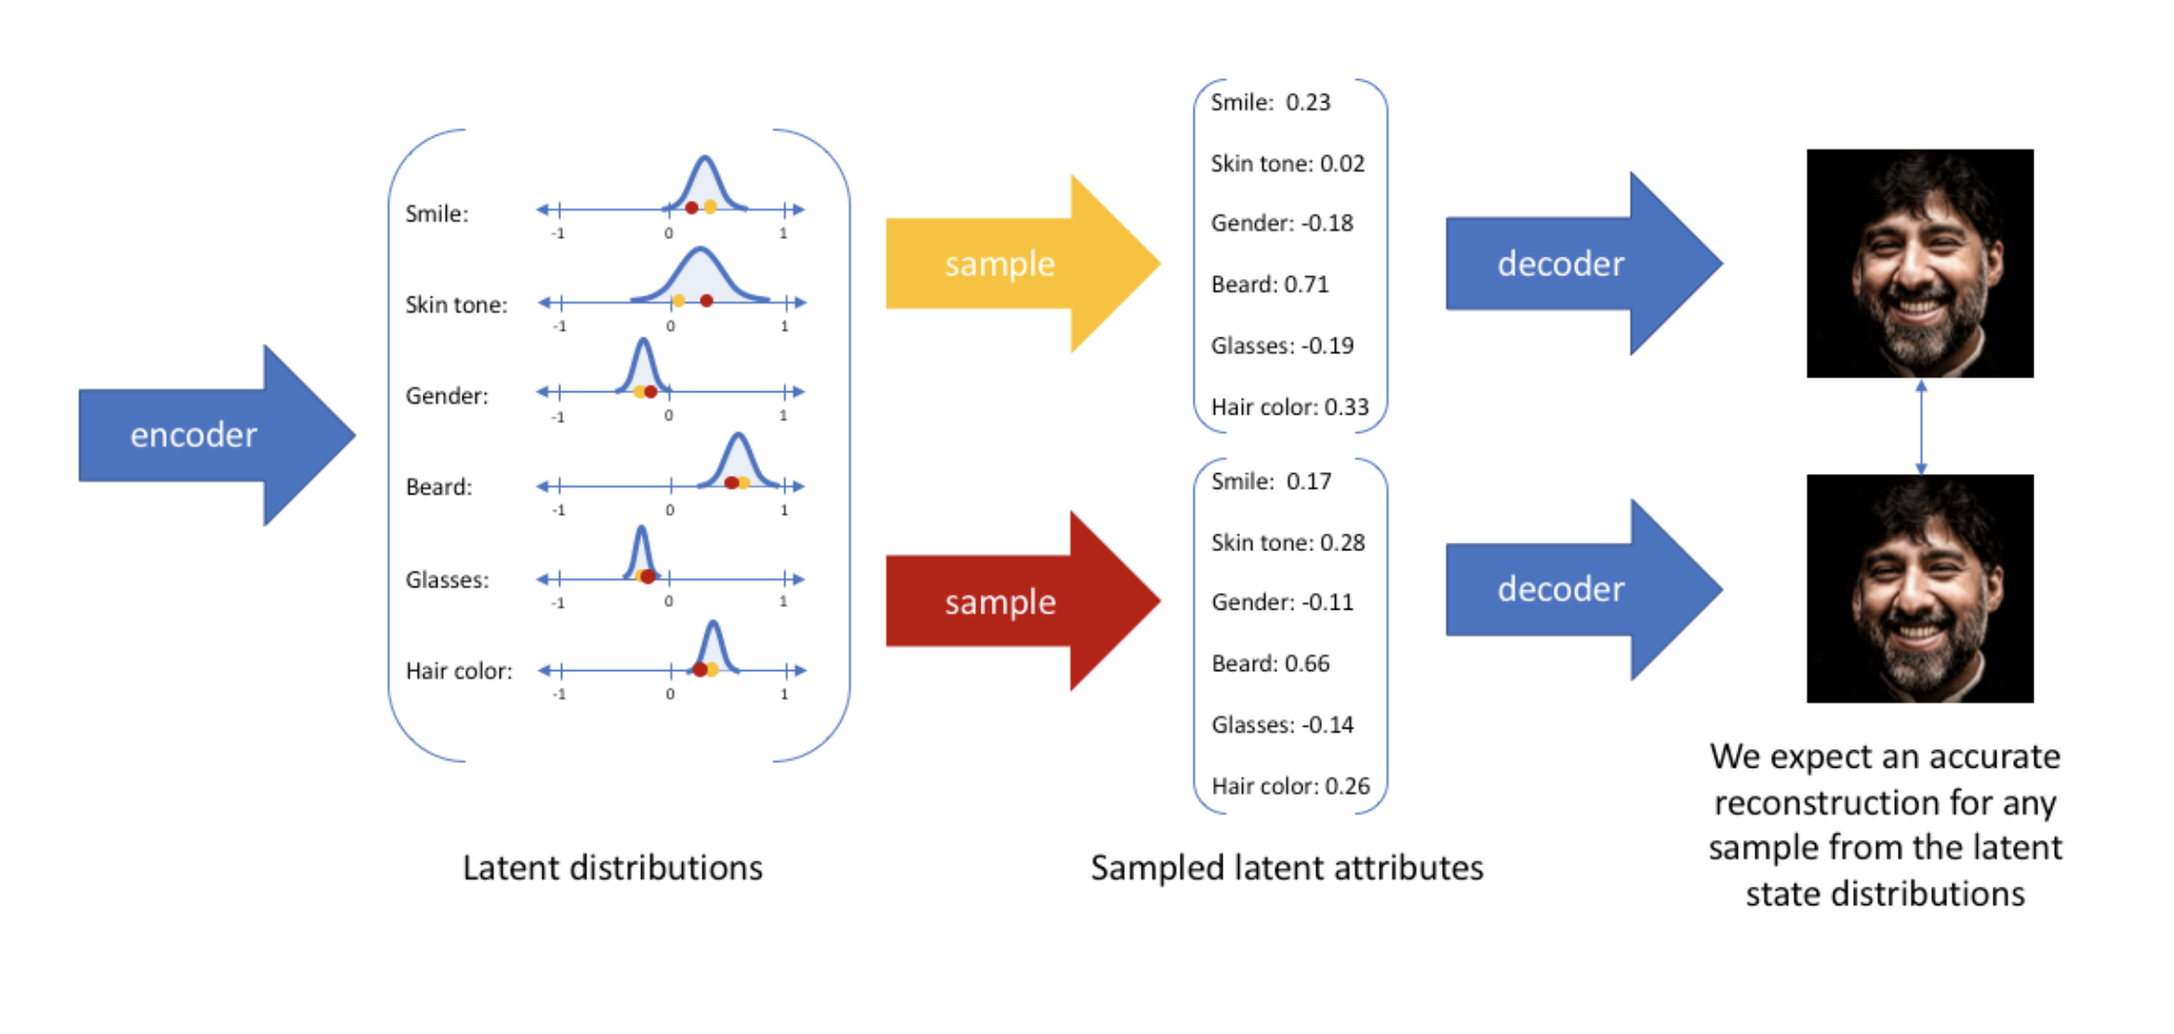
Sampling from latent space

Slide 31
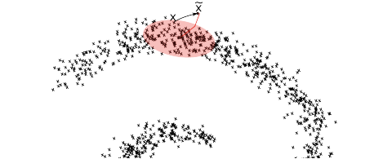
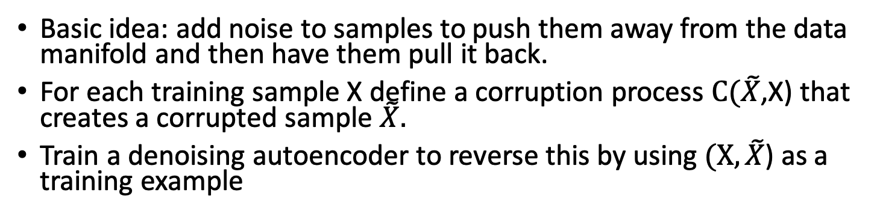
Can we modify a regular autoencoder for generation?
Generalized. Denoising
Autoencoder
[Bengio et al. 2013]
Basic idea: add noise to samples to push them away from the data manifold and then have them pull it back.
For each training sample X define a corruption process $C(\tilde{X}$,X) that creates a corrupted sample $\tilde{X}.$
Train a denoising autoencoder to reverse this by using $(X, \tilde{X}$) as a training example

Slide 32
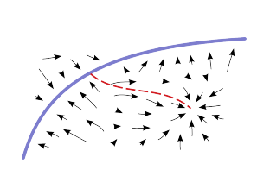
Lost away from the manifold?
Problem: spurious modes
The DAE may not be able to walk back well enough if you get too far away from the sample space

Slide 33
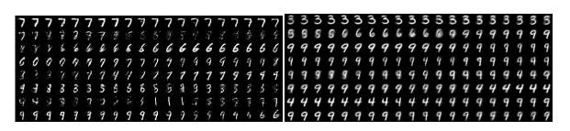
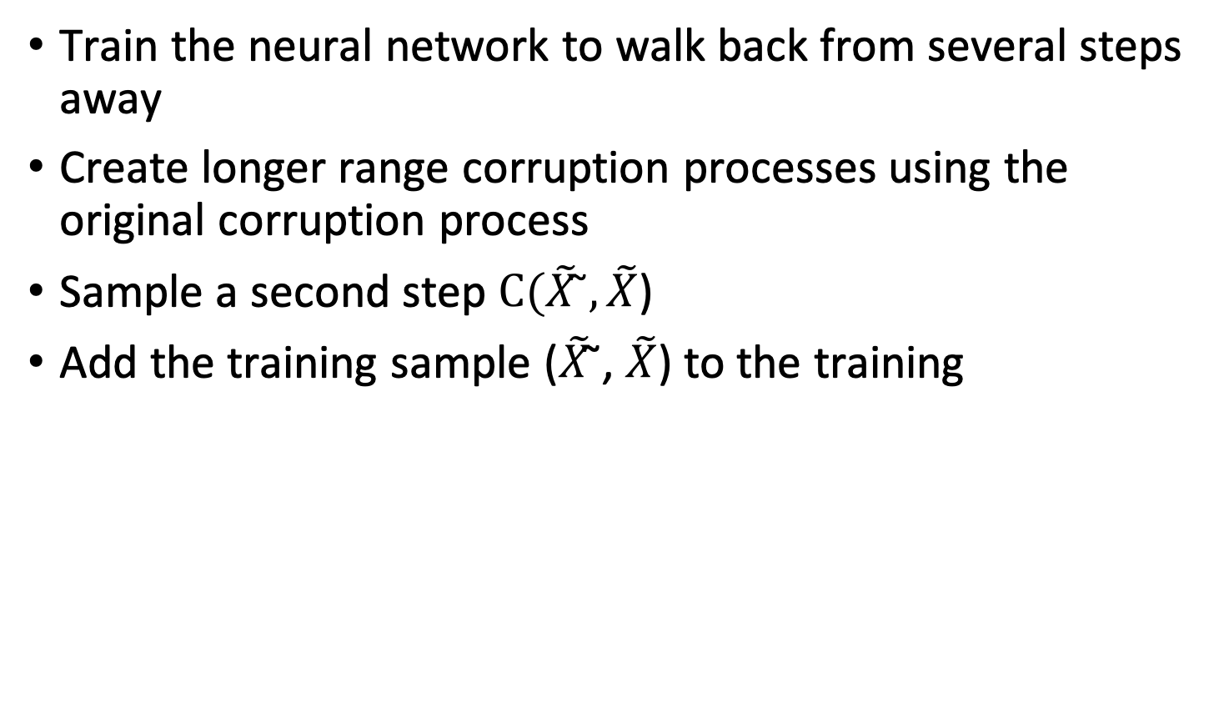
Walkback training
Train the neural network to walk back from several steps away
Create longer range corruption processes using the original corruption process
Sample a second step $C(\tilde{X} \text{̃},\tilde{X}$)
Add the training sample ($\tilde{X}$̃, $\tilde{X}$) to the training
Without walkback
With walkback

Slide 34
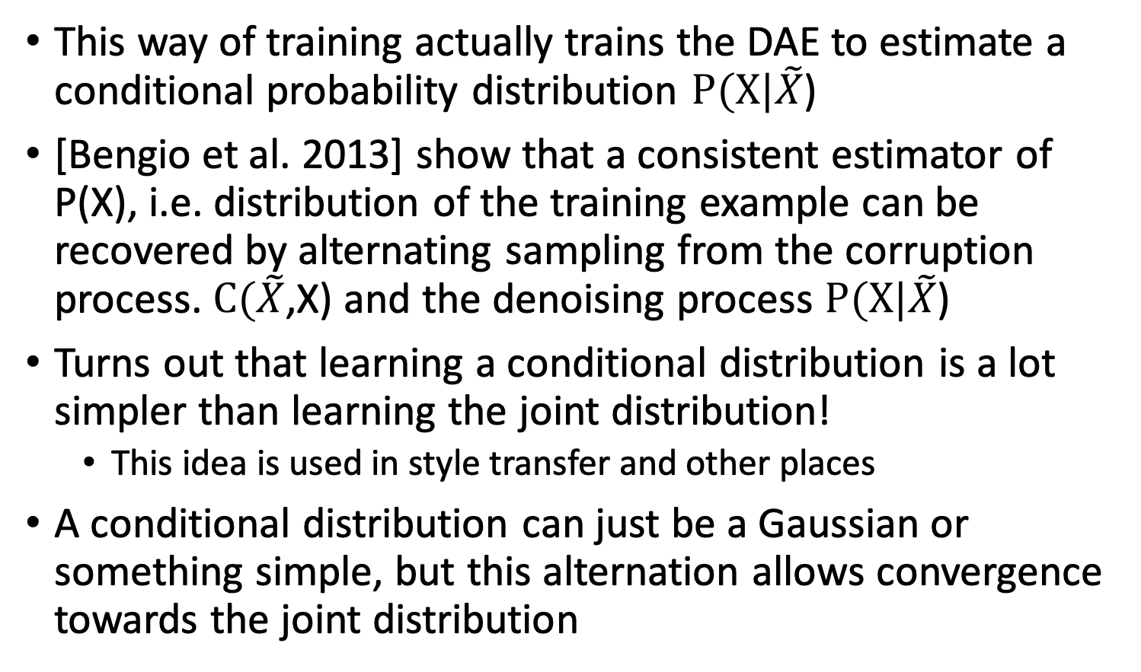
Trains the DAE to estimate conditional
This way of training actually trains the DAE to estimate a conditional probability distribution $P(X|\tilde{X}$)
[Bengio et al. 2013] show that a consistent estimator of P(X), i.e. distribution of the training example can be recovered by alternating sampling from the corruption process. $C(\tilde{X}$,X) and the denoising process $P(X|\tilde{X}$)
Turns out that learning a conditional distribution is a lot simpler than learning the joint distribution!
This idea is used in style transfer and other places
A conditional distribution can just be a Gaussian or something simple, but this alternation allows convergence towards the joint distribution

Slide 35
Issue with this AE
Data generation process is very slow
Its like taking a slow walk through the data
May not span the space
Not penalized to generate the distribution

Slide 36
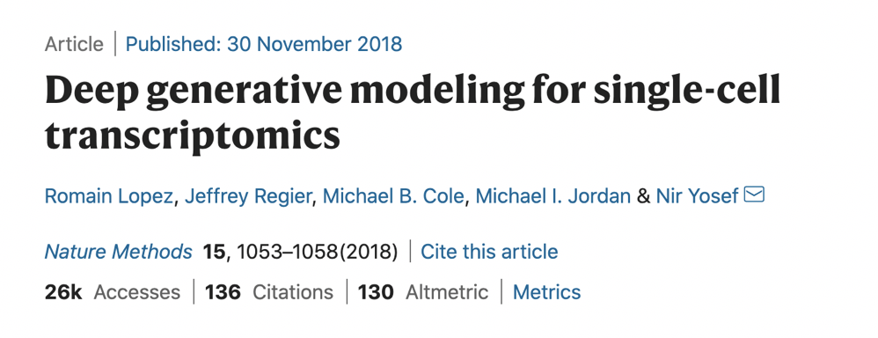
SCVI

Slide 37
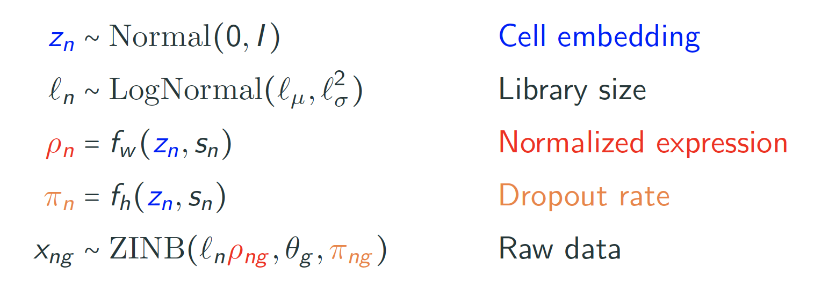
Generative Process Model

Slide 38
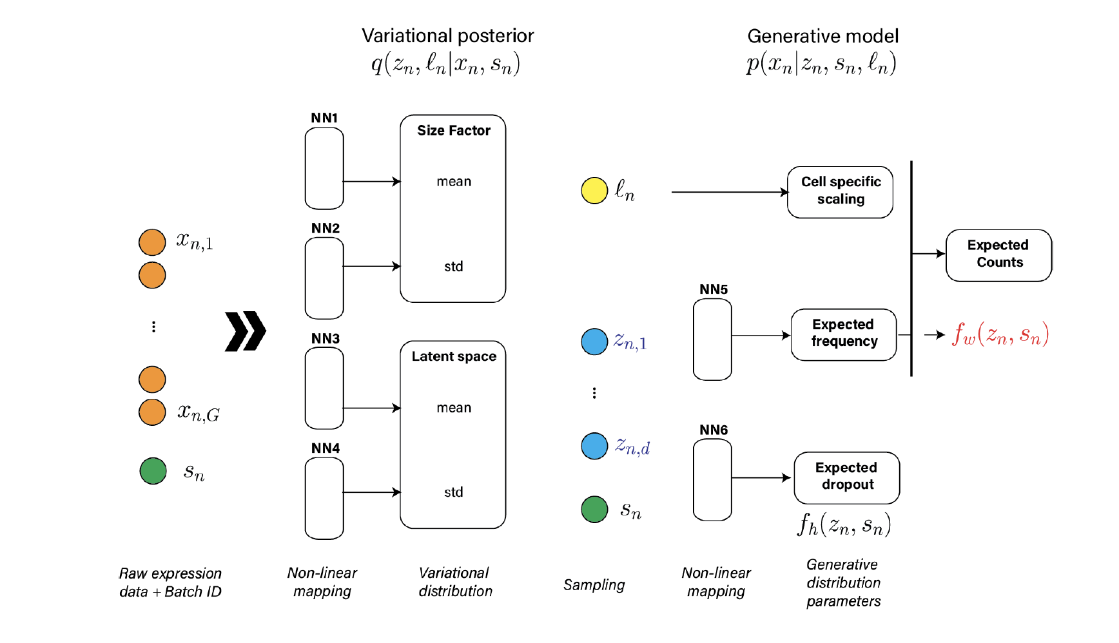

Slide 39



Slide 40
Suggested Reading Blogs
https://towardsdatascience.com/intuitively-understanding-variational-autoencoders-1bfe67eb5daf
https://jaan.io/what-is-variational-autoencoder-vae-tutorial/
Goodfellow et al. Chapter 20

